Slide 1
What the heck are you saying?
Welcome to :
The Language of Dogs

Slide 2
Introductions
Pam Francis-Tuss: Trainer (pamtuss@comcast.net)
YOU:
Name
What brings you here today - goals
Expectation(s)-Commitment

Slide 3
In the end it’s about YOU . . .
The Dogs need US
It takes your commitment to make it happen (each dog trained once a day)
Find what works for you but I implore you to stick with it:
Train the dogs in any capacity
Volunteer for offsites or playgroups
Train and do Adoption Counseling
Notes:
I talked about the need. Each dog is only getting out twice a week. Picture yourself in that environment.
This is it right here. It’s up to us to make it happen. To spend some quality time with each dog once a day.
It’s hard work. Believe me, You’re going to need support, a buddy and a mentor and confidence.
You will need perseverance and to remind yourself often on why you are here, and yes you will sweat and probably bleed
It’s not for everyone and there’s no shame in that. The good news is that it’s scalable. There are options:
Walk small dogs (start small and get big)
Work only outside the kennels on impulse control, getting and keeping attention
Volunteer to help at outreach adoption events
Train and do adoption counseling
So, enough Ra Ra. Let’s get started with the tools for success (yours and the dog’s)

Slide 4
Goals For Our Dogs
Our goals are to help every dog maintain her mental and physical well-being, and to get adopted quickly.
Studies show that dogs that receive training in the shelter get adopted quicker
Have a Team of volunteers for every day of the week working with our dogs!!!!

Slide 5
What is Threshold?
Many if not all of our dogs are at or over their threshold here in the shelter. It’s a scary place to a new dog.
The term “threshold” is often tossed around by dog behavior experts when they talk about working through a canine behavior issue.
What exactly is a threshold? Consider the threshold of a front door. When you cross a threshold, you move from one space to another. A behavior threshold is a similar concept; it’s when your dog crosses from one emotional state to another. If you spend time with a dog who is concerned about other dogs, you have probably witnessed the moment when he or she moves from seemingly okay into out-of-control behavior. That is going over threshold.
Here are five things that everyone can benefit from knowing about thresholds.

Slide 6
Thresholds
1. It’s not always about barking and lunging.
When you are with a dog, you may notice when your dog stops taking treats, stops playing, or suddenly is calmer than usual. These may be a signal that your dog is approaching a threshold, or has even already moved from a comfortable emotional state into an uncomfortable state.
2. Over threshold is more than behaving badly.
When a dog is over threshold it generally means that the dog is behaving in a way that we don’t like. More importantly, it means the dog is in a state of distress.
When a dog crosses an emotional threshold, certain physiological and psychological effects begin to take place. He may not be able to listen to you (or even hear you). In addition, when a dog is over threshold, you cannot teach him to behave differently. A dog will not be able to learn until he back under threshold.
3. Thresholds change constantly!
Unlike the threshold of your front door, an emotional or behavior threshold doesn’t stay in the same place; it can change from minute to minute and from one situation to the next.

Slide 7
Thresholds
4. You can help your dog stay under threshold. To help your dog stay under threshold, you can learn what types of things might be triggers for your dog. Anything that creates stress, high arousal or overexcitement is a possible trigger. Identify both positive stressors (like rowdy play, chasing toys or hunting) and negative stressors (like scary dogs, strangers, or loud noises).
If you notice your dog’s arousal increasing, take action; don’t wait for him to go over threshold. If your dog is getting close to threshold, you can:
✓ Create distance between your dog and the trigger. ✓ Do focus exercises to bring your dog into a thinking state. Or calm touch. ✓ If necessary, leave the situation altogether.
5. If your dog goes over threshold, take action. Let’s face it: We cannot control everything that happens in our lives or dog’s lives here at the shelter. As much as we may try to help our dog stay under threshold, there may be times that he or she steps over and behaves badly. What can you do in that moment?
✓ Get your dog out of the situation immediately. This is not a time for training, learning, or fixing problems. ✓ Take note of all of the factors that led to your dog going over threshold. ✓ Make a plan for the next time you are in that situation, so that you can prevent it from happening again if at all possible.

Slide 8
Thresholds
Understanding the concept of thresholds can help in everyday learning situations for all of our dogs. Keeping a dog under threshold can promote an optimum calm & learning state, which can make training happen faster and with less stress which ultimately leads to a faster adoption. For dogs with behavior challenges such as fear and reactivity, understanding the concept of thresholds and making an effort to keep the dog under threshold while you work through challenges can make a huge difference in progress and success.
Understanding thresholds gives you an advantage when it comes to training and to helping our dogs be calm and confident.

Slide 9
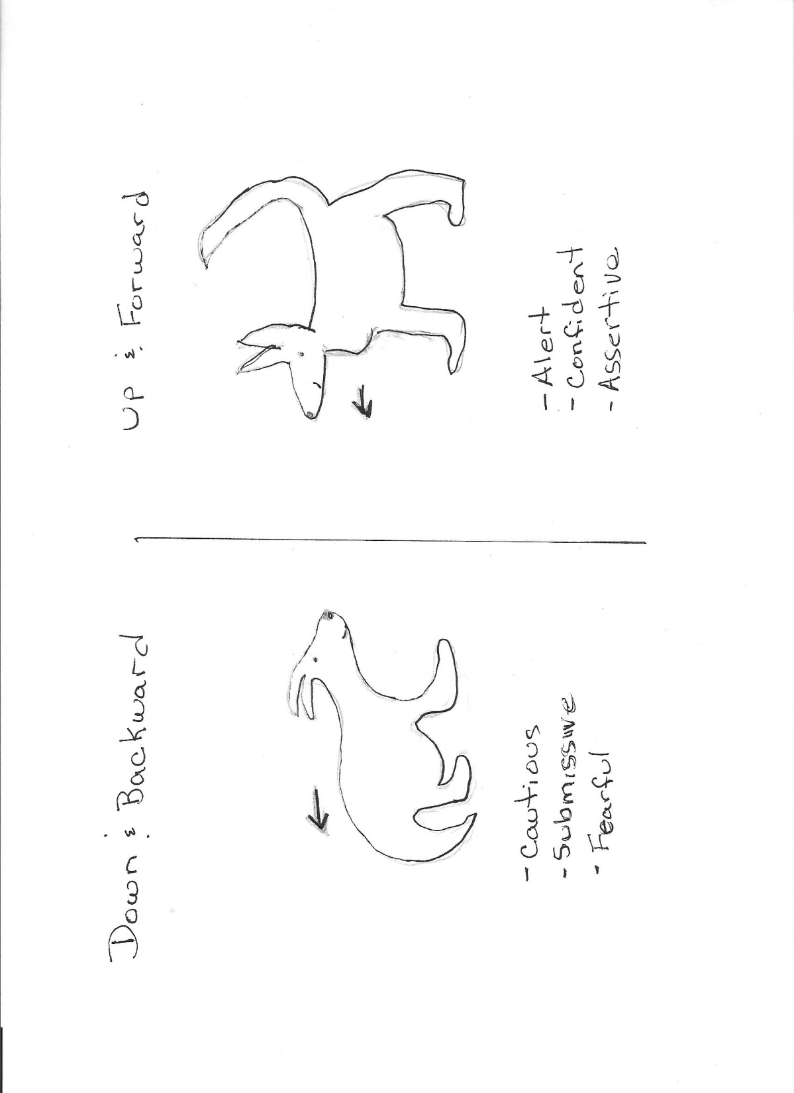

Slide 10
:PLEASE remember….GO ON-LINE
to sign-up for any & all tasks here at the shelter (We look at this to know if our staff will have help or not) Don’t just show up!!!!
Don’t forget to LOG all your hours. Please be specific when logging your hours. If you cleaned kennels for 2 hours and worked with the dogs for 2 hours PLEASE log in twice to show that, don’t log all that time in one area.
If you need help doing any of these……PLEASE ASK FOR HELP!!!
Most important…..THANK YOU!!!!

